Slide 1

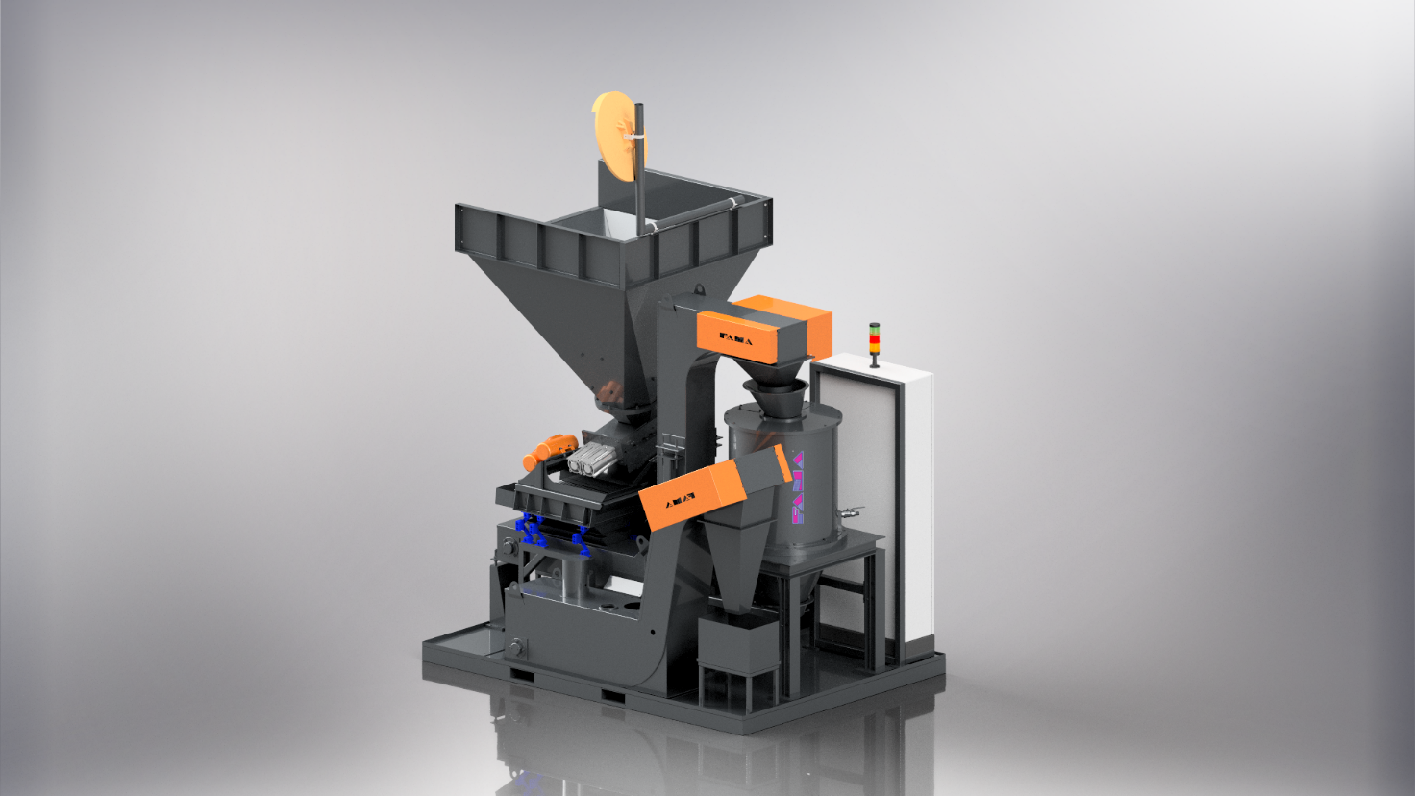
REV
0.0
STANDARD COMPACT GROUPS
COMPACT 43D
COMMERCIAL SHEET
SUPPLY
CRUSHER TTC400
CENTRIFUGE FC300
PIECES SEPARATION SCREEN
SCRAPING CONVEYOR
DREDGED TANK
ELECTRIC PANEL
STANDARD COLOUR RAL 7016
DESCRIPTION
The compact group COMPACT 43D consists of the combination of a TTC range crusher and an FC range centrifuge. It is a treatment unit suitable for swarf contained in small and medium-sized bins that are discharged into the crusher hopper.
The long and coiled swarf, dirty with coolant, is ground by the crusher and loaded into the centrifuge by means of a scraping conveyor.
The coolant recovered from the centrifuge is stored inside a collection tank.
The unit is able to work even if the swarf contains pieces, as the crusher is equipped with an automatic ejection system.
The entire unit is mounted on a palletised platform to make it easier to handle. It is delivered ready for use as it is wired and complete with an electrical control panel.
ACCESSORIES / OPTIONAL
TIPPER ELEVATOR
DIFFERENT COLOURING
Plug & Play
Compact
Industry 4.0
Ready
Easy Maintenance
Configurable
FAMA s.r.l | Via del Terziario, 20 36016 Thiene (VI) ITALY |Tel.+39 0445 363 950 | Fax +39 0445 386068 | www.famaproject.com | info@famaproject.com

Slide 2

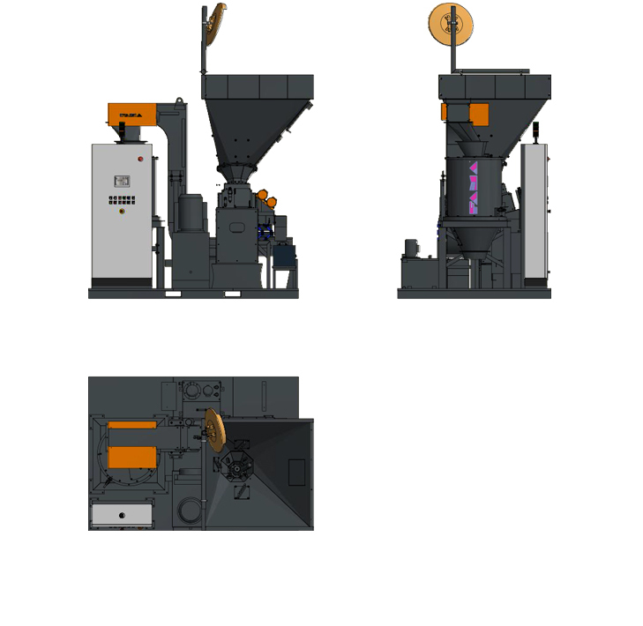
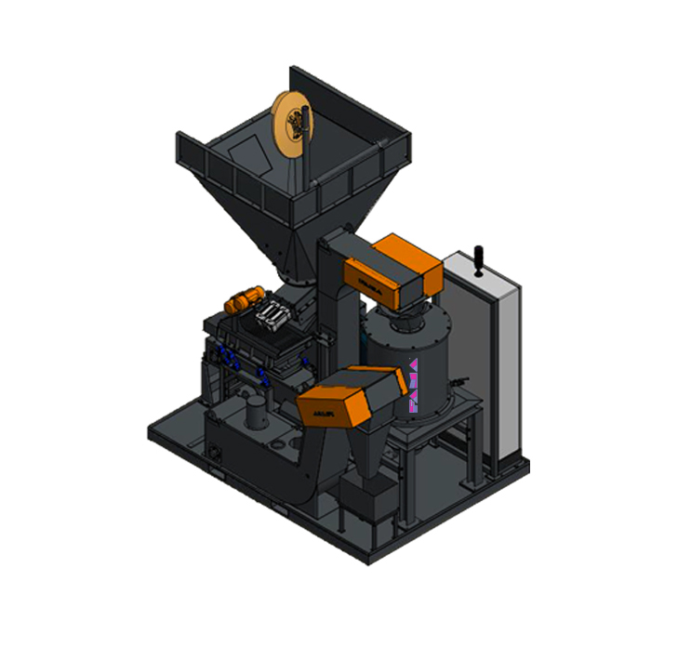
LOADING OF SWARF
C
E
TTC400
SCRAPING CONVEYOR
A
B
SCREEN
ELECTRICAL PANEL
FC300
LOADING OF SWARF
DREDGED TANK
D
 | DIMENSIONS
A | - GROUND LONG SIDE SPACE | 2800 mm
B | - GROUND SHORT SIDE SPACE | 2000 mm
C | - MAXIMUM HEIGHT SPACE | 3950 mm
D | - MAXIMUM LENGTH SPACE | 3000 mm
E | - HOPPER LOADING HEIGHT | 2700 mm
 | TECHNICAL DATA
 | TOTAL WEIGHT | 3400 kg
 | TOTAL POWER | 10.5 kW
 | ELECTRICAL POWER SUPPLY | 400V 22A
 | SWARF HOURLY FLOW RATE | 100 ÷ 400 kg/h
 | HOPPER LOADING VOLUME | 400 l
 | HOURLY PRODUCTION
 | Q = 0,6 m³/h | BRASS | STEEL | ALUMINIUM | STAINLESS STEEL | COPPER
 | ∆ DENSITY [kg/dmc] | 0,45 ÷ 1 | 0,50 ÷ 1 | 0,15 ÷ 0,30 | 0,40 ÷ 1 | 0,25 ÷ 1
 | Kg/h | 270 ÷ 500 | 300 ÷ 500 | 90 ÷ 180 | 240 ÷ 500 | 150 ÷ 500
 | THE DATA IN kg/h IS APPROXIMATE AND IN ANY CASE DEPENDS ON THE DENSITY OF THE SWARF, THE SHAPE, THE TYPE AND THE THICKNESS. THE DENSITY VALUES CONSIDERED ARE HYPOTHETICAL, BASED ON AN EXPERIMENTAL AVERAGE OF THE DATA IN OUR POSSESSION. PRIOR TESTS CAN BE PERFORMED.
 | FAMA s.r.l. reserves the right to make changes to the product without notice
FAMA s.r.l | Via del Terziario, 20 36016 Thiene (VI) ITALY |Tel.+39 0445 363 950 | Fax +39 0445 386068 | www.famaproject.com | info@famaproject.com

